Slide 1
Regional Solutions to Workforce Readiness
Northern Illinois Regional P-20 Network
Amy Jo Clemens, NIU P-20 Center
Diana Robinson, NIU Center for Governmental Studies
Joanne Kantner, Kishwaukee College Adult Education and Transitions
Edith Njuguna, NIU Education Systems Center
James Carlson, Superintendent Seneca District 160

Slide 2
Northern Illinois Regional
P-20 Network
The Illinois P-20 Council’s goal is to increase the proportion of adults in Illinois with high-quality degrees and credentials to 60% by the year 2025.
The Northern Illinois Regional P-20 Network collaborates to increase college and career success for our students through regional action toward the 60/2025 goal.

Slide 3
Participating Institutions
Community Colleges | School Districts
College of DuPage | Naperville 203
College of Lake County
Elgin Community College | Elgin U-46
Harper College | Arlington Heights HS 214 Barrington HS 220 Palatine HS 211
Illinois Valley Community College | Seneca Township HS 160
Kishwaukee College | DeKalb 428 Rochelle HS 212 Sycamore 427
McHenry County College | Huntley 158
Rock Valley College | Rockford 205
Sauk Valley Community College | River Bend 2, Rock Falls 301, Sterling 5
Waubonsee Community College | Hinckley-Big Rock 429 Kaneland 302
Education Agencies and Organizations
IL Board of Higher Education
IL Community College Board
IL State Board of Education
Advance Illinois
Early Childhood Action
IL Business Roundtable
IL P-20 Council
IL Workforce Investment Board
Northern Illinois University
Northwest Educational Council for Student Success
University Center of Lake County
4 C (B-3rd)

Slide 4
Benefits of a Regional Network
System-level approaches across all levels
Convening and facilitating
Sharing best practices and inspiration for change
Increased involvement in state policy development
Professional think tanks
Training
Research: 14 surveys, 2 policy papers, 4 lit reviews, 3 research reports, more in process
Resources

Slide 5
Challenges
Need for long-term, dedicated support
Delivering results on time
Sustaining involvement
Geography
Diversity of member institutions
Change fatigue
Coordination with local and state-level activity; avoiding duplicating or complicating other efforts
Disruptive information and innovations
Resources

Slide 6
Northern Illinois Regional P-20 CEOs
Monitor and Direct Five Work Groups
Alignment of Standards
100% of students graduate from high school with 9-12 college credits and/or a professional certificate.
Articulation & Adult Learners
Create seamless transitions across the education continuum from cradles to careers, including adults returning to the classroom.
Student Support Services
Coordinate student support systems across institutions to ease transitions and increase success.
Birth-3rd Grade
Collaborate with ongoing activities at state and regional levels that prepare children from birth to grade 3 for success in school, family, and community life and to design initiatives that address unmet needs identified through research.
Workforce Development
Coordinate Regional P-20 Network's workforce development activities with local, state, and national initiatives to more closely align academic offerings and student preparation with workforce needs.

Slide 7
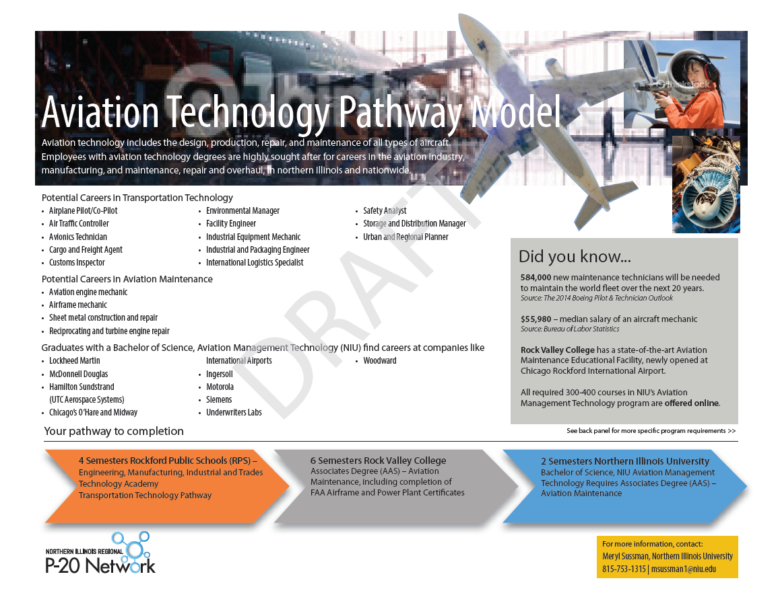
Career Pathway Models

Slide 8
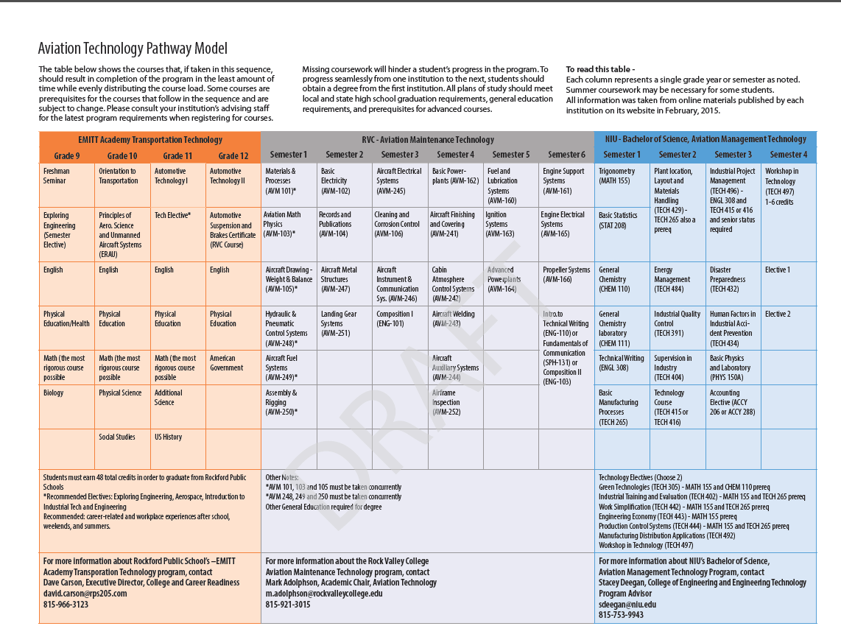

Slide 9
Workforce Innovation and Opportunity Act (WIOA)
WIOA innovates the workforce development system by enhancing partnerships, strategic planning and service delivery alignment at the state, regional, and local levels.
WIOA requires connecting education and training to workforce needs at state, regional and local levels.
WIOA requires state boards to develop strategies to support the use of career pathways.
WIOA requires local workforce boards and education partners to develop and implement career pathways aligned to local high demand industries.

Slide 10
WIOA Partnerships

Slide 11
WIOA Definition: Career Pathways
A combination of rigorous and high quality education, training, and other services that— (A) aligns with the skill needs of industries in the regional and local economy; (B) prepares an individual to be successful in any of a full range of secondary or postsecondary education options.

Slide 12
Regional P-20 Supporting WIOA Implementation
Strategic Planning
  Knowing the region's needs and resources to achieve goals
System Involvement
  Engaging stakeholders in the process as part of the solution
Evaluation & Improvement
  Data-driven strategies that can be measured
Career Pathways Development
  Self-study resource to develop programs that align with the skill needs of industries in the economy

Slide 13

Using Workforce Data in Educational Programming
Core workforce questions:
What types of jobs do we want to prepare our students for?
What level of demand are we likely to see?
What do our students need to be prepared to access good jobs and careers?

Slide 14
What types of jobs should we prepare our students for?
Think regionally
  More reflective of labor sheds
  More and more detailed data
Who else is engaged in workforce planning (and how can we leverage their efforts)?
  Local Workforce Innovation Areas
  Community Colleges
  Economic Development Agencies
  Employer Associations
  Regional Planning Organizations
  Universities

Slide 15
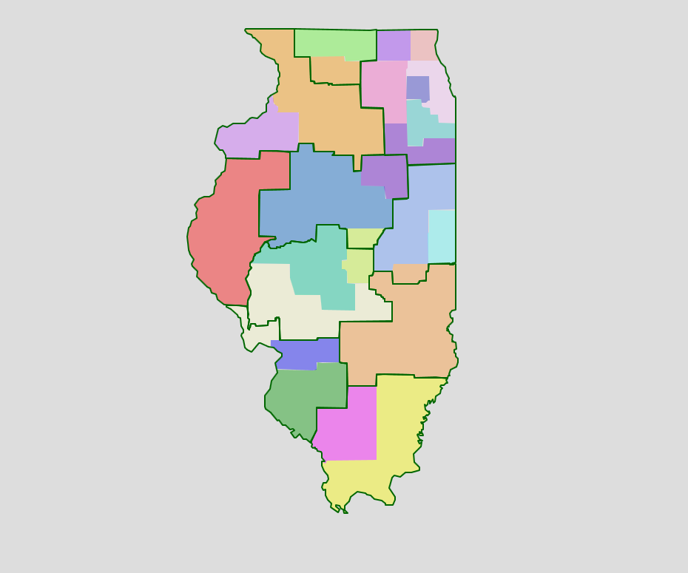
Primary Geographies for
Workforce Data

Slide 16

What To Look For
Basic labor market dynamics – sectors, occupations, trends
Where largest/fastest growth is occurring
  Expansion vs. turnover
  Impact of demographic change
New and emerging jobs
Needs of different clusters
  Leading/growth
  Emerging
  Mature
Living wage jobs (MIT)

Slide 18

What level of demand is likely?
Look at current demand as well as short- and long-term
Current: Real-time LMI (Help Wanted Online, Burning Glass) but subscription-based or large area (EDR)
Employment projections are available
  Detail only for large areas
  County data is aggregated

Slide 19
How do we manage supply in light of this demand?
Understand what employers need – focus on basic employability and workplace literacy skills
Develop estimates of the student pipeline and compare with areas of demand.
Collaborate with workforce partners to agree on priority sectors, occupations
Think about new models: talent pipeline management, youth apprenticeship, career pathways
Use the “Discussion Framework” to begin the conversation

Slide 20
Seneca High School
Using Jobs Data to Guide
Educational Decisions

Slide 21
Backstory
Board Goals
Series of Staff Presentations
New Mission, Vision, and Core Values
Curriculum Model: Emphasis on Core Competencies
Instructional Model: More Inquiry less Direct Instruction
Focus on Life After High School

Slide 22
Problems
1. With the retirement of a CTE Instructor and a declining enrollment, how do we balance our course offerings and right size our staff?
2. Are we offering our students the CTE opportunities that will lead to a career? (Jobs Data)
3. How can we consolidate sections with lower enrollment while minimizing singletons?
4. During second semester, several sections of course offerings experience attrition in student enrollment.
5. How can we promote work-based learning opportunities?

Slide 23
Desired Outcome
SHS offers a modern CTE program which will allow students:
To earn college credit or a certification;
To develop skills necessary for the workplace success;
Of all ability levels to experience success; and
To pursue their aptitudes and interests.

Slide 24
Variables
Space limitations
Prerequisites
Equipment requirements
Modifications to existing course curricula
Jobs data
Block Scheduling
Territoriality

Slide 25
Timeline
September 1 Email to-do list Guidance & consult with SRAVTE
September 3 Want Ads & Occupational Projections review
September 4 Meeting with Guidance
September 9 Task Document Emailed
September 11 Introductory Meeting with CTE Department
September 17 Want Ads & Occupational Projections to CTE
September 21 Email Emerging Jobs Report from NIU P20 Network
September 29 Problem-Solving Meeting #1 with CTE/Guidance
October 8 Problem-Solving Meeting #2 with CTE/Guidance
October 20 Draft Solution
October 23 Draft Solution Review
October 30 Edit changes – Final Recommendation
November 15 Final Recommendation to Guidance

Slide 26
Using Jobs Data
Affirm what we have been hearing
Educate administration, guidance, & CTE staff
Analyze our current offerings and curriculum
Gave us permission to dream
Contributed to a problem solving mode

Slide 27
And the Jobs Data Said…
Truck Drivers
Production – Assembler, Fabricator, Welder
Logistics
Engineers
IT
Maintenance/Repair/Mechanics
---------------------------------------------------------------------
Health Care
Retail
Food Service

Slide 28
Solution
Preserved all programs
Reduced Sections
Updated Course Names
Updated Foci of Curricula
Added New Courses
All One Department

Slide 29
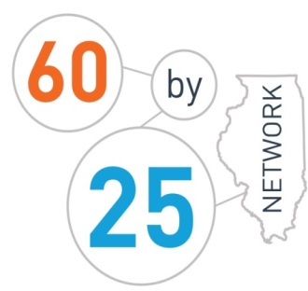
Mission
  Supporting regions to increase meaningful and equitable postsecondary attainment

Slide 30
How does the 60 by 25 Network support regions?
Manage a peer-to-peer learning and action network by:
  Holding an annual convening to bring together communities, technical experts, and state/national leaders
  Documenting and sharing best practices in partnership with internal and external members
  Connecting local community efforts to state policy to advance the state’s 60 by 25 goal
Provide technical assistance on collective impact, college and career pathways, work-based learning, and other strategies to support regions to increase meaningful and equitable postsecondary attainment

Slide 31
Additional Supports for Leadership Communities
Provide a mechanism to gather and curate critical data using a community dashboard that communities can use to:
  Analyze regional information on education and workforce system characteristics and performance
  Track progress on postsecondary education attainment and education-to-career objectives
  Benchmark community efforts against state averages
  http://dashboard.il60by25.org/
Serve as a conduit for financial support to communities for strategies to increase meaningful and equitable postsecondary attainment

Slide 32

Leadership Communities
Documented partnership involving employers, education, municipal leadership, & community-based organizations
Defined geographic community of focus
Plan for key strategies for increasing meaningful and equitable postsecondary attainment:
  Prioritized STEM industry clusters for career pathway systems
Identified trusted intermediary organization
5. Engage in peer-to-peer learning through the Network
6. Use data for continuous improvement
Aurora Regional Pathways to Prosperity
East Side Aligned
Health Professions Education Consortium of Lake County
McLean County
NCI/Starved Rock Region
Northwest Educational Council for Student Success
Peoria Pathways to Prosperity

Slide 33
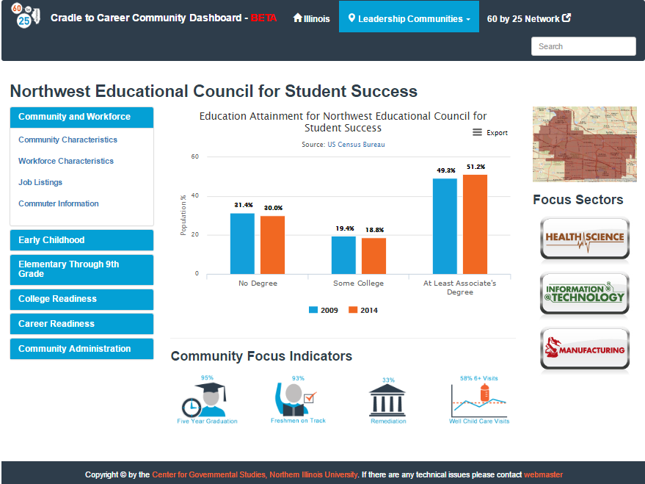
Community Dashboard

Slide 34
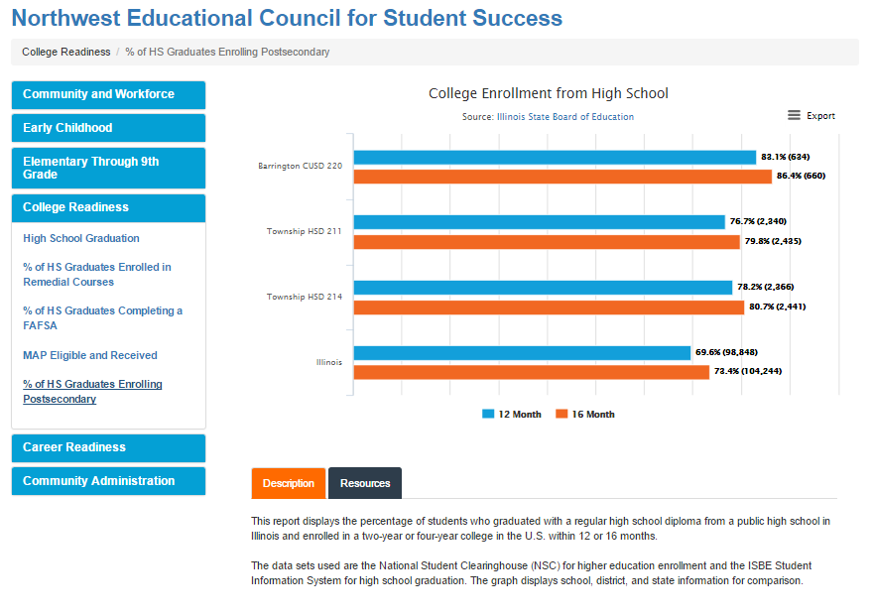
Community Dashboard

Slide 35
Future Focus
Grow the regional “coalition of the willing”
Continue to direct technical assistance and philanthropic resources to participating communities
Work with agencies to align to state plans and state and federal funding streams
Expand and further customize the dashboard tool

Slide 36
Contact Information
Amy Jo Clemens, NIU P-20 Center
ajclemens@niu.edu
Diana Robinson, NIU Center for Governmental Studies drobinson@niu.edu
Joanne Kantner, Kishwaukee College Adult Education and Transitions joanne.kantner@kishwaukeecollege.edu
Edith Njuguna, NIU Education Systems Center enjuguna@niu.edu
James Carlson, Superintendent Seneca District 160
jcarlson@senecahs.org

